Slide 1
Rethinking Memory Management in Modern Operating System — Memory optimization using hardware features and application characteristics
Lei Liu (SKL, ICT, CAS)
Talk in Huawei U.S. C.A
2015, 7, 30

Slide 2
Executive Summary
Background & Motivation
Topic 1: Optimization Memory System by OS Approach
Topic 2: Going Vertical!
Topic 3: SYSMON: Making OS understand it!
Topic 4: Our on-going work (if time permits)

Slide 3
Background & Motivation

Slide 4
Organization of shared memory system
Core 0
Core 1
Core 2
Core N
...
Shared Memory System
Shared Cache
Memory Controller
On-chip
Chip Boundary
Off-chip
DRAM
Bank 0
DRAM
Bank 1
DRAM Bank 2
...
DRAM Bank K

Slide 5
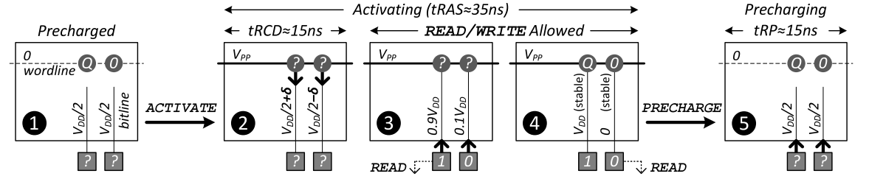
Interferences on DRAM Banks -- DRAM Conflicts
Row-Buffer Conflicts
Row-Buffer
2 times Thrashing of Row 1: increases latency
Bank
Memory Latency = N*tRC (Caused by Row-Buffer Thrashing) + I/O Latency

Slide 6
The Performance Lost -- Caused by Inter-thread Interferences
Shared cache^{[Zhuravlev+,ASPLOS10]}
50% performance degradation
Shared DRAM^{[Moscibroda+,Security06, Onur]}
Unfair: 1.09x v.s. 11.35x
System slowdown: 2.9x v.s. 6x
Impact Overall System Performance and QoS Seriously!

Slide 7
Topic 1: Optimizing Memory System by OS Approaches -- “Horizontal” Memory Policies
Most of the contents are in our PACT-2012 and ACM TACO-2014 Papers.

Slide 8
Page-Coloring Partitioning Approach
Page-coloring technique has been proposed to partition cache.
Four-way Associativity
Physical address
00
Frame No.
Page Offset
Thread 1
01
Thread 2
Cache Sets
10
Cache Set Bits
Thread 3
11
Thread 4

Slide 9
Bank bits in PFN
Some bits in Page Frame Number (PFN) denotes the bank address
We could extend page-coloring to partition banks
DRAM Banks

Slide 10
Partitioning Banks into Groups
Banks are colored into diff. groups
Thread 1
Thread 2
Thread 3
DRAM Banks
Reducing the available amount of banks that one thread can access

Slide 11
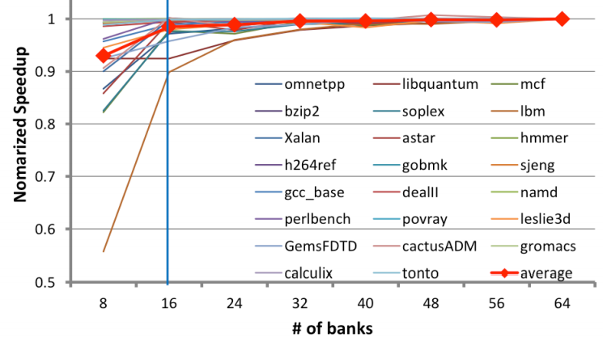
The necessary bank amount
Will this influence performance?
The necessary amount of banks one program
requires is limited

Slide 12
Overview of Our Mechanism

Slide 13
Bank-level Partition Mechanism (BPM)
Implementation: adopt page-coloring base BPM in Linux kernel 2.6.32 by modifying its buddy system.
group free pages into 32 colors.
Adjust the page allocation algorithm in OS.

Slide 14
Experiment Environment
System Configuration
-- 4-core/8-thread Intel Core i7-860 CPU 2.8GHz
-- LLC: 8MB/16 ways of associativity
Memory Configuration
-- Micron DDR3-1333
-- 2 Channel, 8 Ranks, 64 Banks
Workloads
-- 23 benchmarks from SPEC CPU 2006 (Multi-Program)
-- PARSEC (Multi-Thread)

Slide 15
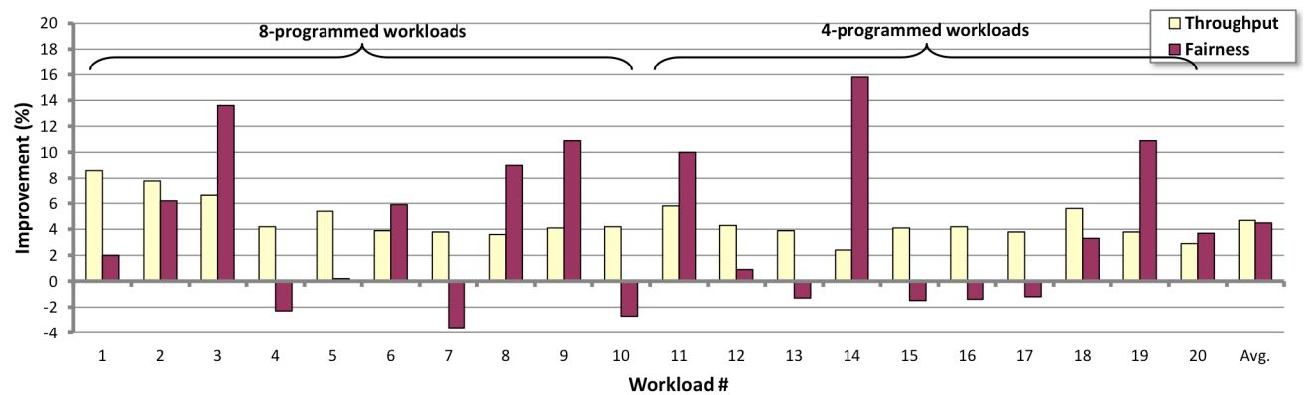
Experimental Results
System throughput : 4.7%↑ (up to 8.6%)
Maximum slowdown: 4.5%↓ (up to 15.8%)
Memory Power : 5.2% ↓
A Software Memory Partition Approach for Eliminating Bank Level Interferences (PACT-2012)

Slide 16
Extend BPM to BPM+
Reducing the Channel Level interferences
“blindly” interleaving
BPM+, Let each thread use a specific channel
BPM/BPM+: Software-based Dynamic Memory Partitioning Mechanism (ACM TACO-2014)

Slide 17
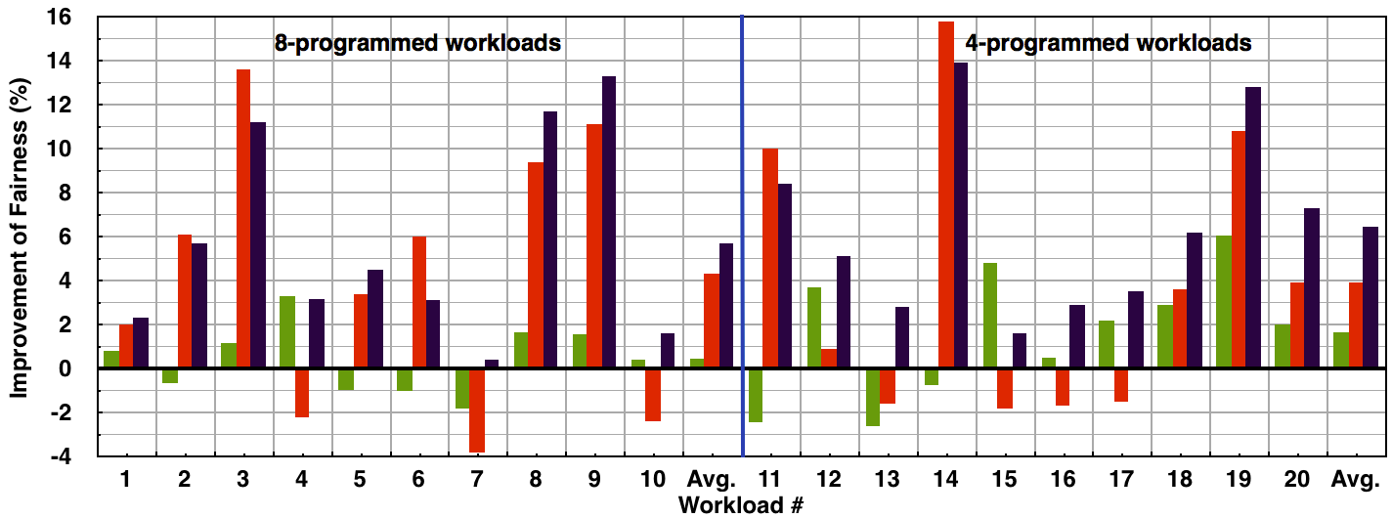
Overall System Performance

Slide 18
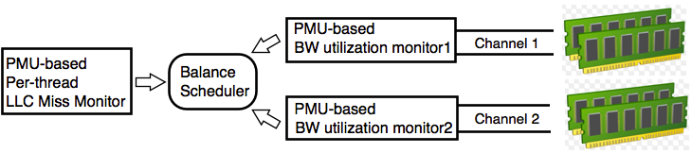
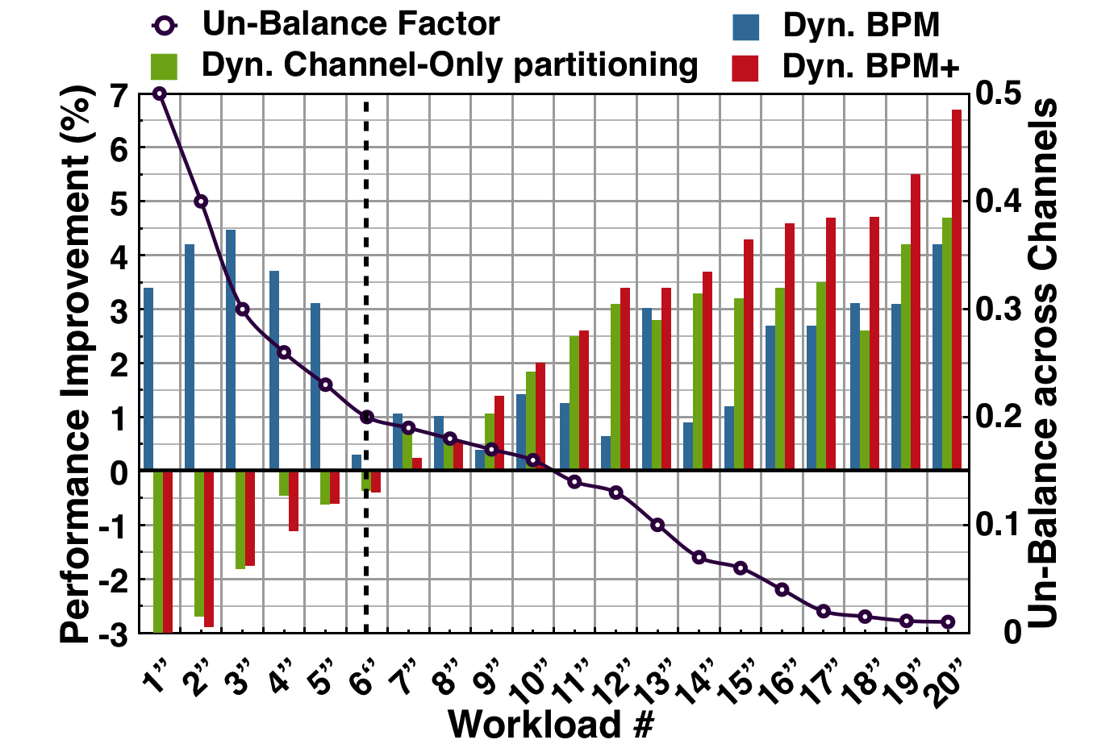
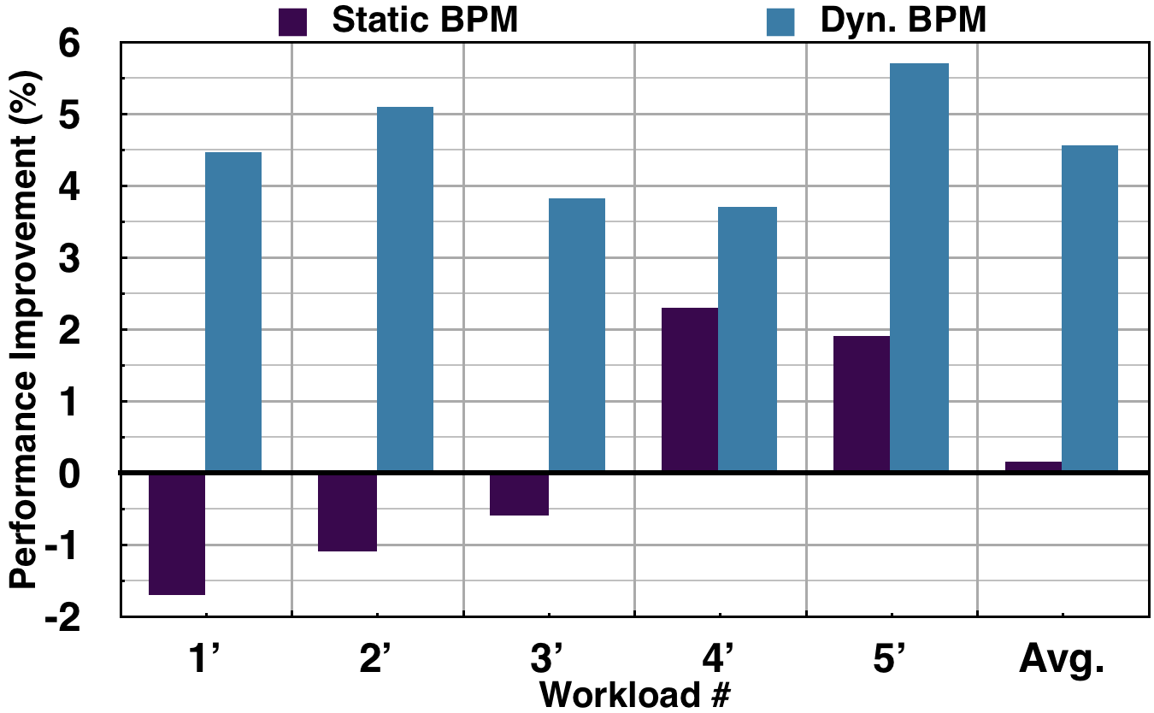
Memory Optimization Framework -- Supporting Dyn. and Flexible Scheduler

Slide 19
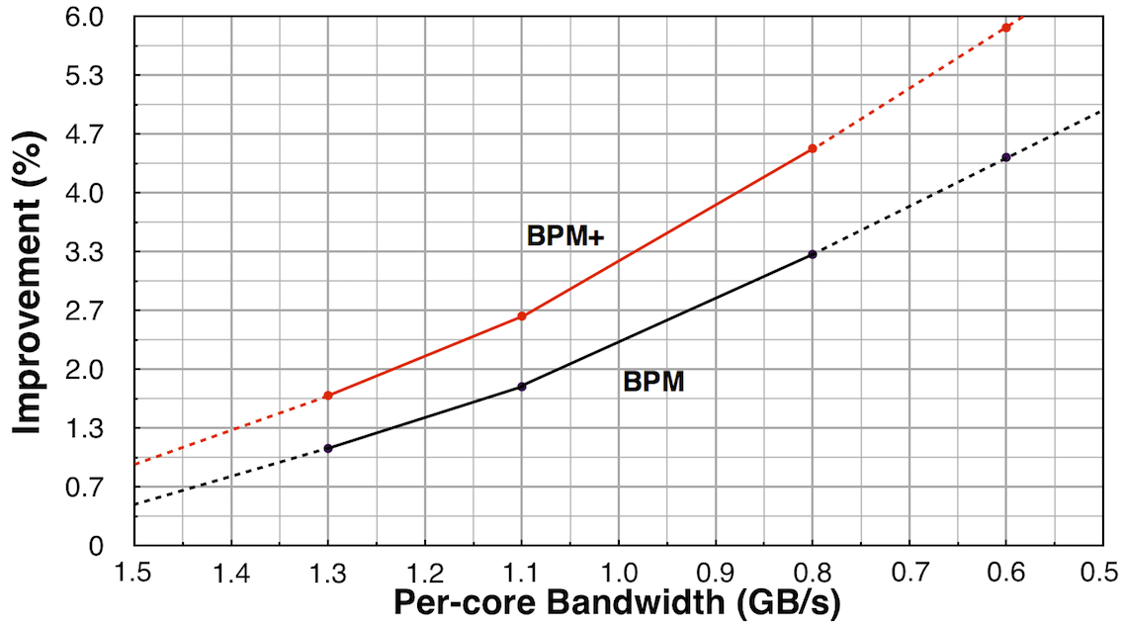
BPM/BPM+ and Per-core Bandwidth
BPM(+) is promising for future multi-/many-core platforms that have even less per-core bandwidth

Slide 20
In What We Win?
A practical software approach for eliminating Bank-level Interferences
-- Without any hardware modification to MC
-- Could be deployed on real system easily
-- Improves both fairness and system throughput
-- Saves energy consumption of memory system

Slide 21
Topic 2: Going Vertical in Memory Hierarchy -- Exploiting the potential optimization space
Most of the contents are in our ISCA-2014 and IEEE Trans. on Computers-2015 Papers.

Slide 22
Study the Effectiveness of “Horizontal” Partitioning

Slide 23
“Horizontal” Partitioning: Cache VS. DRAM -- Programs are from SPECCPU2006
Whether the two horizontal approaches work cooperatively?

Slide 24
Architecture Features in Modern Multicore Systems
B-/C-/O-Bits in Address Mapping
The address Mapping of Intel i7-860 w/ 8GB Memory

Slide 25
“Vertical” Partitioning using O-Bits
Cache Set
Cache Line
T1 T2 T3 T4
Last Level Cache
DRAM Banks

Slide 26
Partitioning Space in Entire Memory Hierarchy
The address Mapping of Intel i7-860 w/ 8GB Memory
Notes:
.

Slide 27
The History of Page-Coloring
--Cross-layer Cooperative Vertical partitioning

Slide 28
The Performance Gains on Vertical Partitioning

Slide 29
They are in the quadrant ONE
How to obtain the workloads’ sensitivity at runtime?

Slide 30
How to Leverage the Potential Optimization Space? -- Combining Application’s Memory Patterns and Hardware Features

Slide 31
What affects Vertical Partitioning?
Cache sensitivity impacts VP
LLCH: Last Level Cache High Requirement LLCT: LLC Thrashing
LLCM: LLC Middle Requirement CCF: Core Cache Fitting

Slide 32
The Classification of SPECCPU2006
Diverse memory features on Cache and DRAM

Slide 33
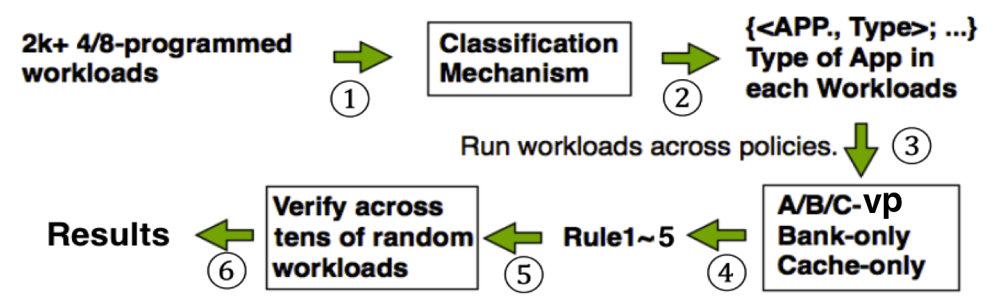
Data Mining: Classification → Best-Fit Partitioning
Algorithm: Using APRIORI algorithm to discover A → B
Modeling：{lib, mcf, bzip, hmmer} →
{<lib, LLCT>, <mcf, LLCH>, <bzip, LLCM>, <hmmer, CCF>}
→ <cache-only, x%>, <bank-only, y%>, <A/B/C-VP, z%>

Slide 34
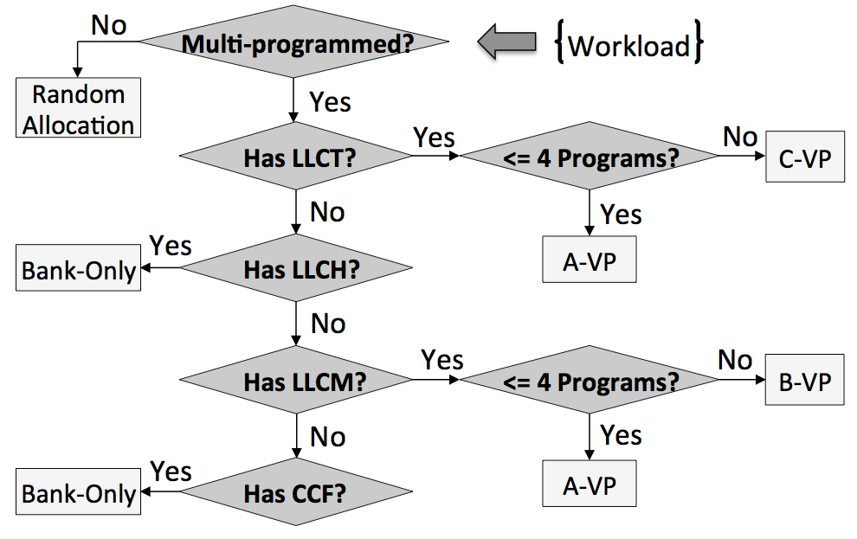
Handling Multiplicity by Multi-policy -- Memory Policy Decision Tree
Who is “stronger”：LLCT > LLCH > LLCM > CCF

Slide 35
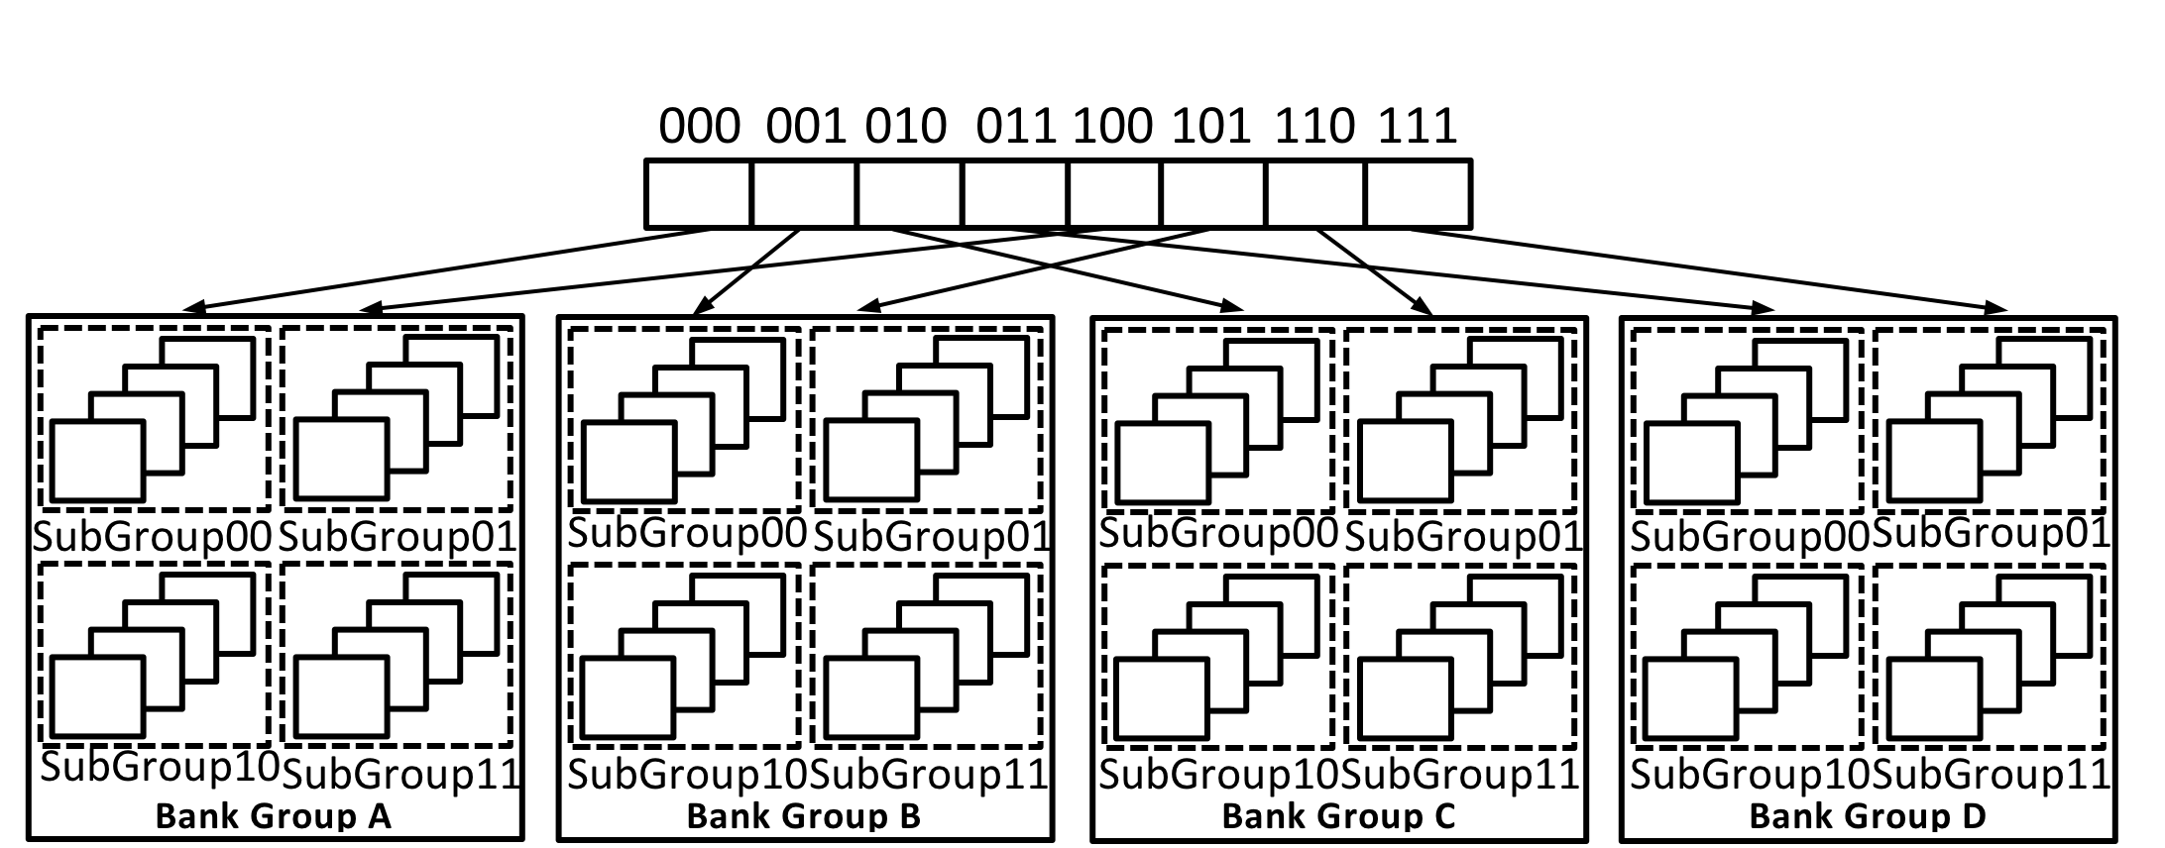
Supporting Partitioning and Coalescing -- Real Case: “Curve-Vertical” Partitioning
2xLLCT (e.g. 462.Lib, causing cache thrashing)
4xLLCH or LLCM (e.g. mcf, astar.)
*Principle1*: To isolate LLCT applications since it will interfere other application seriously.
*Principle2*: The number of DRAM Banks one application will use is limited.
15~20% performance benefits, outperforming Cache-/Bank-only “Horizontal” partitioning
IEEE Trans. on Computer-2015

Slide 36
Topic 3: SYSMON -- Making OS understand the memory patterns

Slide 37
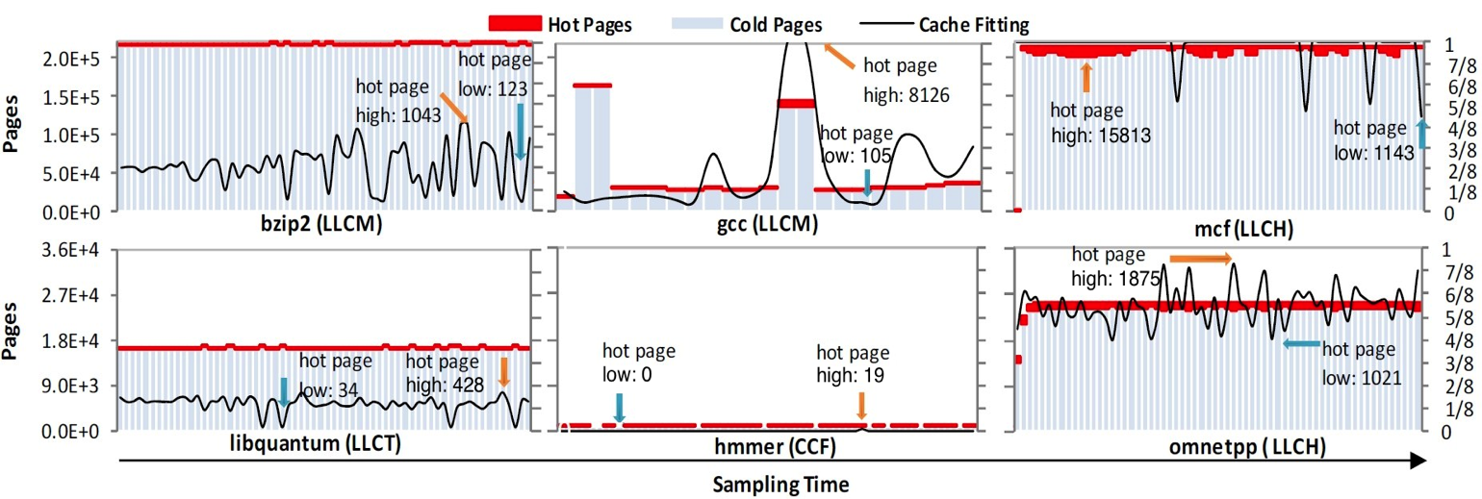
SYSMON: Cache Utilization, Hot/Cold Page, Memory Footprint
It detects __access_bit in PTE, and then distinguishes “cold” and “hot” pages.
It indicates the max requirements of Cache utility of one thread by counting the number of “hot” pages.

Slide 38
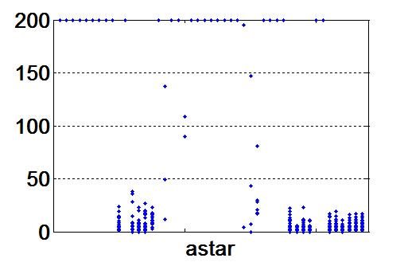
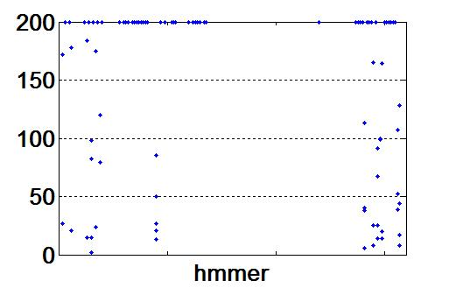
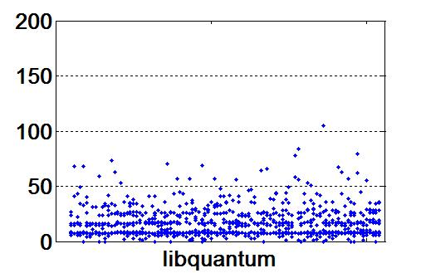
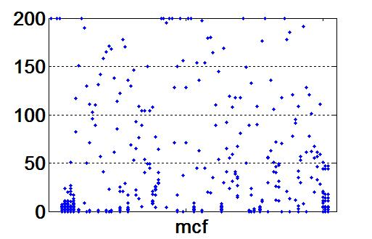
SYSMON: Profiling Page-Level Re-use Time
Lower is better

Slide 39
SYSMON: “Locality” and “Hot” Freq.
Better Locality
Low access Freq.

Slide 40
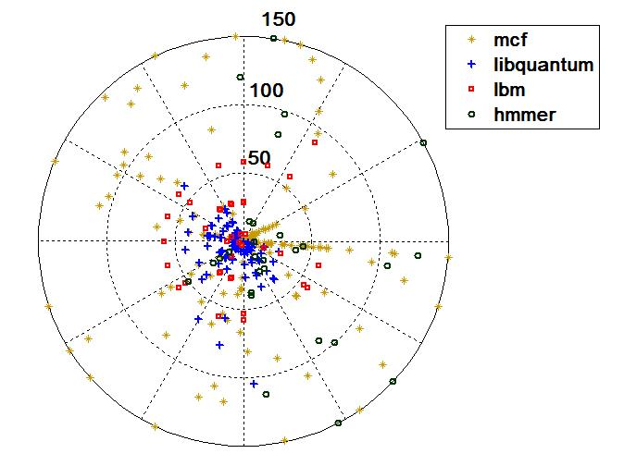
SYSMON: Random Sampling
-- To Handle application with Large Footprint
-- Lower sampling overhead,
but Similar results.
-- Runtime Sampling
-- Easy to be developed
-- Diverse platforms
5~10% PTE is enough to reflect the memory behavior

Slide 41
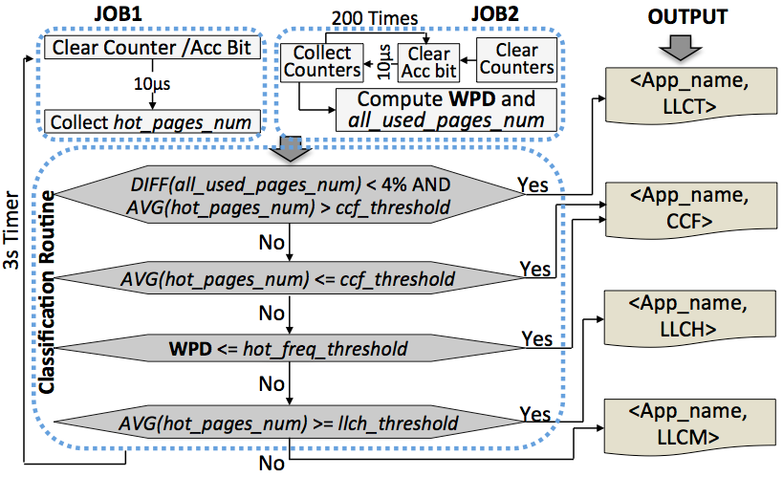
SYSMON: Classification based on Sampling Results
Weighted Page Distribution →“Locality”
WPD= (2xVH + 1.5xH +1xM + 0.5xL + 0.1xVL) / all_used_pages_num

Slide 42
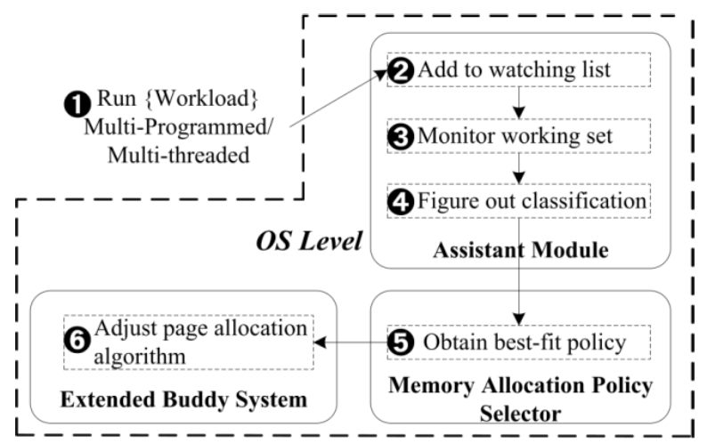
Let it Run On-the-Fly! -- Multi-Policy Framework: Supporting Diverse Memory Allocating Policies

Slide 43
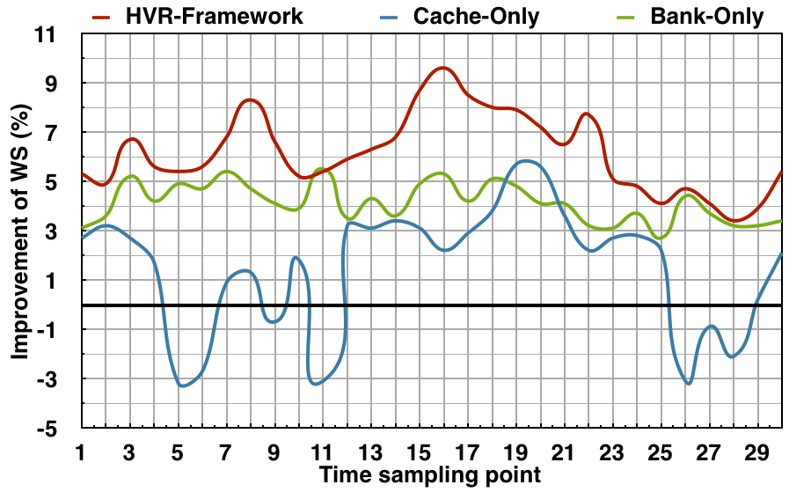
Experimental Results
Horizontal, Vertical, Random (HVR) Framework outperforms the “Horizontal” Partitioning
More experimental results can be found in our paper.

Slide 44
Conclusion
Horizontal and Vertical Partitioning
-- Brings up to 21% improvement
-- Outperforms the Horizontal partitioning
Closing the “gap” between arch. and OS
-- Makes OS take advantages of arch. Features
-- Application-Arch.-Aware Memory Management (HVR)
Memory optimization
-- We try to approach it from OS angle
-- Optimizes the memory allocating/organizing in the root

